Slide 1
Introduction to SDLC
BUSINESS PLAN
Reporter:

Slide 2
What is SDLC?
SDLC is a process that defines the various stages involved in the development of software for delivering a high-quality product.
SDLC is to deliver a high-quality product which is as per the customer’s requirement.

Slide 3



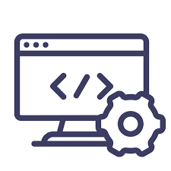



Phases of SDLC

Slide 4
SDLC Models
Waterfall Model
V- Shaped Model
Prototype Model
Spiral Model
Agile Model

Slide 5
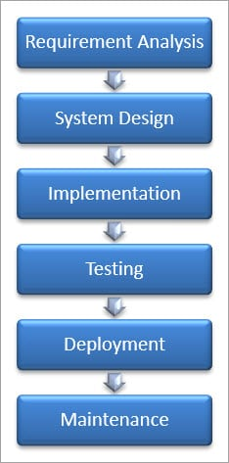
Waterfall Model

Slide 6
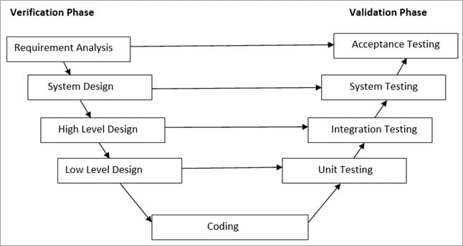
V- Shaped Model

Slide 7
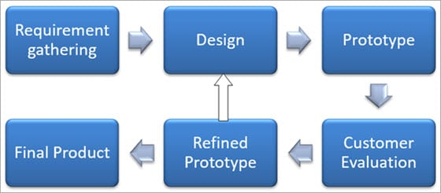
Prototype Model

Slide 8
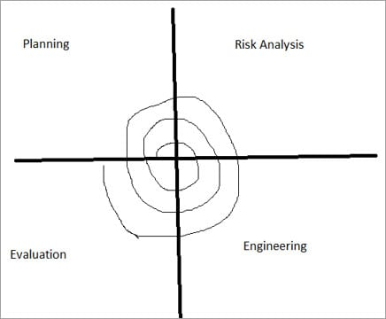
Spiral Model

Slide 9
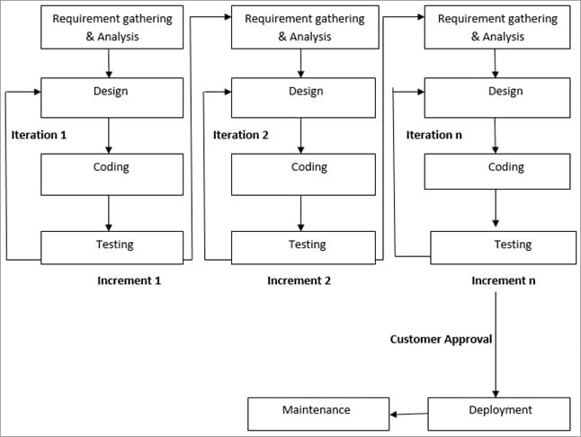
Agile Model

Slide 10
Thank You

